Slide 1

Attendance System Using Face Recognition
Team 19
Keshavan Seshadri 20171051
Neerja Gangwar 2019201020
Shreya Vanga 2019201087
Ayush Deva 201501098
Nikhil Jakhar 20171186
Pranay Gupta 20161088

Slide 2

Table of Contents
01
02
Software Learnings
03
04
Project Management and Planning
Further tasks and improvements
Solution and Innovation

Slide 3
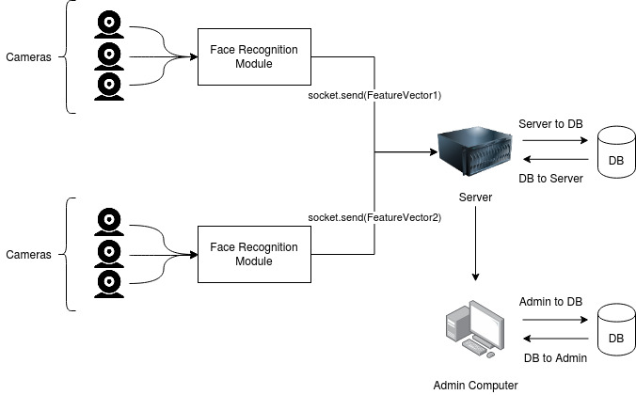
Solution Overview
Choose whether to mark attendance or enroll
Obtaining camera feed on each client
Facial embedding from each clients
Sending facial embedding to server.
Finding match in the database, if marking
Enrolling new student, if chosen enrollment

Slide 4

Innovation
To solve the problems with inefficient existing system, we came up with an idea of recording attendance using face detection with multiple cameras, to manage students coming from multiple entrances
Why it is better ?
Efficient
Proxy not possible
Saves time
Scalable for bigger classrooms and crowds

Slide 5
Software Learnings
Clean Code Principles :
Variable names(Camel case) method names (Screaming snake case)
Not more than 2 parameters in a function
Clear precise comments.
Refactored code
Documentation complete
SOLID Properties Satisfied wherever applicable:
Single responsibility : All classes and methods have single responsibilities.
Open/Close : Every module can be extended, without changing the other methods
Interface segregation principle : No additional, unused methods, new interfaces can be added when required
Dependency Inversion Principle : The modules are decoupled, the client vector doesn’t depend on facenet, it can send over any vector of any size or type.
Notes:
-Agile Methodolgy
-SCRUM
-ACID Properties
-Distributed techniques Used :- Data Partitioning (APbased)
-Data Abstraction And OOP concepts
-Backlogs
-Working and testing with remote team
-(High level design (modularity),flexibility in product in terms of changes)
-SOLID Principles
- Choice of programming language paradigm and why?
- Design Patterns Used

Slide 6
Software Learnings
Properties of the final Project:
Modularity
Flexible towards expansion.
Scalable
Applied Distribution System : - Ap System
Consistency here depends on the facenet, a deep model
Availability: Via multithreading we have ensured that the server is available for each client.
Partial Tolerance : Since the number of entrances can be limited, tolerance not an issue.
Notes:
-Agile Methodolgy
-SCRUM
-ACID Properties
-Distributed techniques Used :- Data Partitioning (APbased)
-Data Abstraction And OOP concepts
-Backlogs
-Working and testing with remote team
-(High level design (modularity),flexibility in product in terms of changes)
-SOLID Principles
- Choice of programming language paradigm and why?
- Design Patterns Used

Slide 7
Project Management and Planning.
We tried to follow the Agile SCRUM methodology.
Divided into 2 scrum teams.
A sprint was one week, and we had sprint review and planning sprint at the end of each sprint, with daily stand ups.
We had one major Product backlog, while teams managed sprint backlogs on trello.
We couldn’t do retrospective meetings given the time constraints.
Each scrum team worked on a branch and we integrated it into master, once the added feature was working without bugs

Slide 8
Integration and Testing
We first made the basic server and client and then all the other functionalities could to be added exclusively, using the input/out definitions.
Each team worked on a functionality, wrote its unit test and added. Unit Tests for one module were implemented as a class, so it was easy to extend.
We finally manually tested the combined functionalities after they were pushed.
We used python unittest module for writing the tests.

Slide 9
Future Work
We couldn’t integrate a working gui for the app.
Right now it works on facial image features, but biometric features would be better for the task.
Dependent on resources, even though the model works good enough on cpu, because only evaluation is needed, but still work can be done in that direction.
Identifying people from one image, currently it takes a feed.
Testing on IIIT network, where server and client are on remote machines, wasn’t possible due to lockdown

